Slide 1
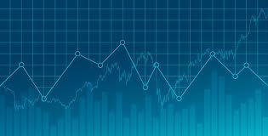
Simulating the Stock Market with an Irrational Agent-Based Model
Alex Chang

Slide 2
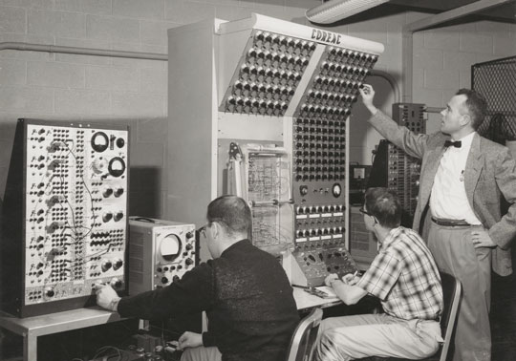
A Brief History of Economics
The Wealth of Nations, Adam Smith (1776)
Efficient Market Hypothesis (1900)
Computation revolution (1960s)

Slide 3
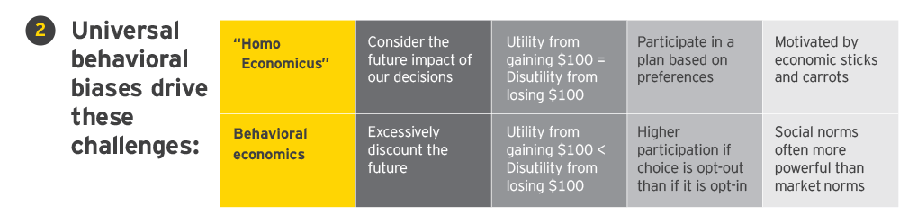
Modern Economics
Prospect Theory: An Analysis of Decision Under Risk (1979)
Richard Thaler wins Nobel Prize (2017)
Neuroeconomics

Slide 4

Agent-Based Modeling (ABM)
Santa Fe Artificial Stock Market (2002)
Experience based reinforcement learning, Brock, Hommes, and Wagener (2009)

Slide 5
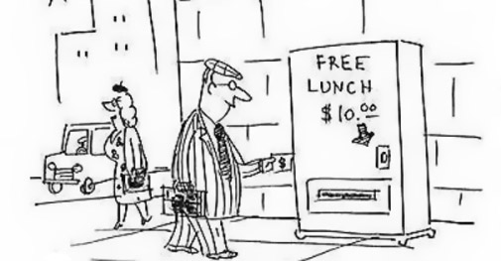
Developing a new model
To make ABMs more accurate for financial modeling, irrational (emotional) factors will be taken into account when determining agent behavior.
These factors will include personality traits such as risk tolerance, contrarianism, adaptability, optimism, reactionism, etc

Slide 6
Project Roadmap
The model is being implemented in Java, based on the mechanics of the Santa Fe Artificial Stock Market.
Initial Conditions
The Model
Final Conditions
Stock Price
Buy Orders
Stock Price
Agent Population
Market
Trading Volume
Sell Orders
Previous Performance
Trading Volume

Slide 7
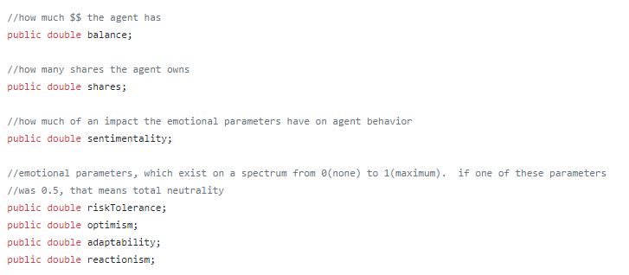
Agent Implementation (agent.java)

Slide 8
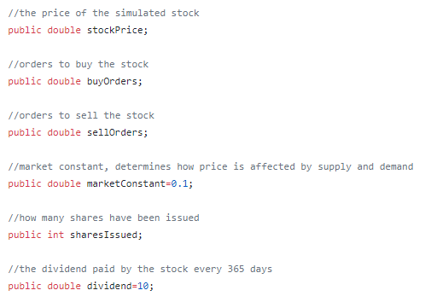
Market Implementation (market.java)

Slide 9

Next Steps
Code the world in which the agents and market will exist.
The world will initialize the agent populations, keep track of experiment data, and handle the interactions between the agents and the market.

